Slide 1
DATA SCIENCE
11 WEEK PART TIME COURSE
Week 3 - Logistic Regression
Wednesday 6th April 2016

Slide 2
AGENDA
Motivation
What is Logistic Regression?
Why use Logistic Regression
Lab
Homework Review

Slide 3
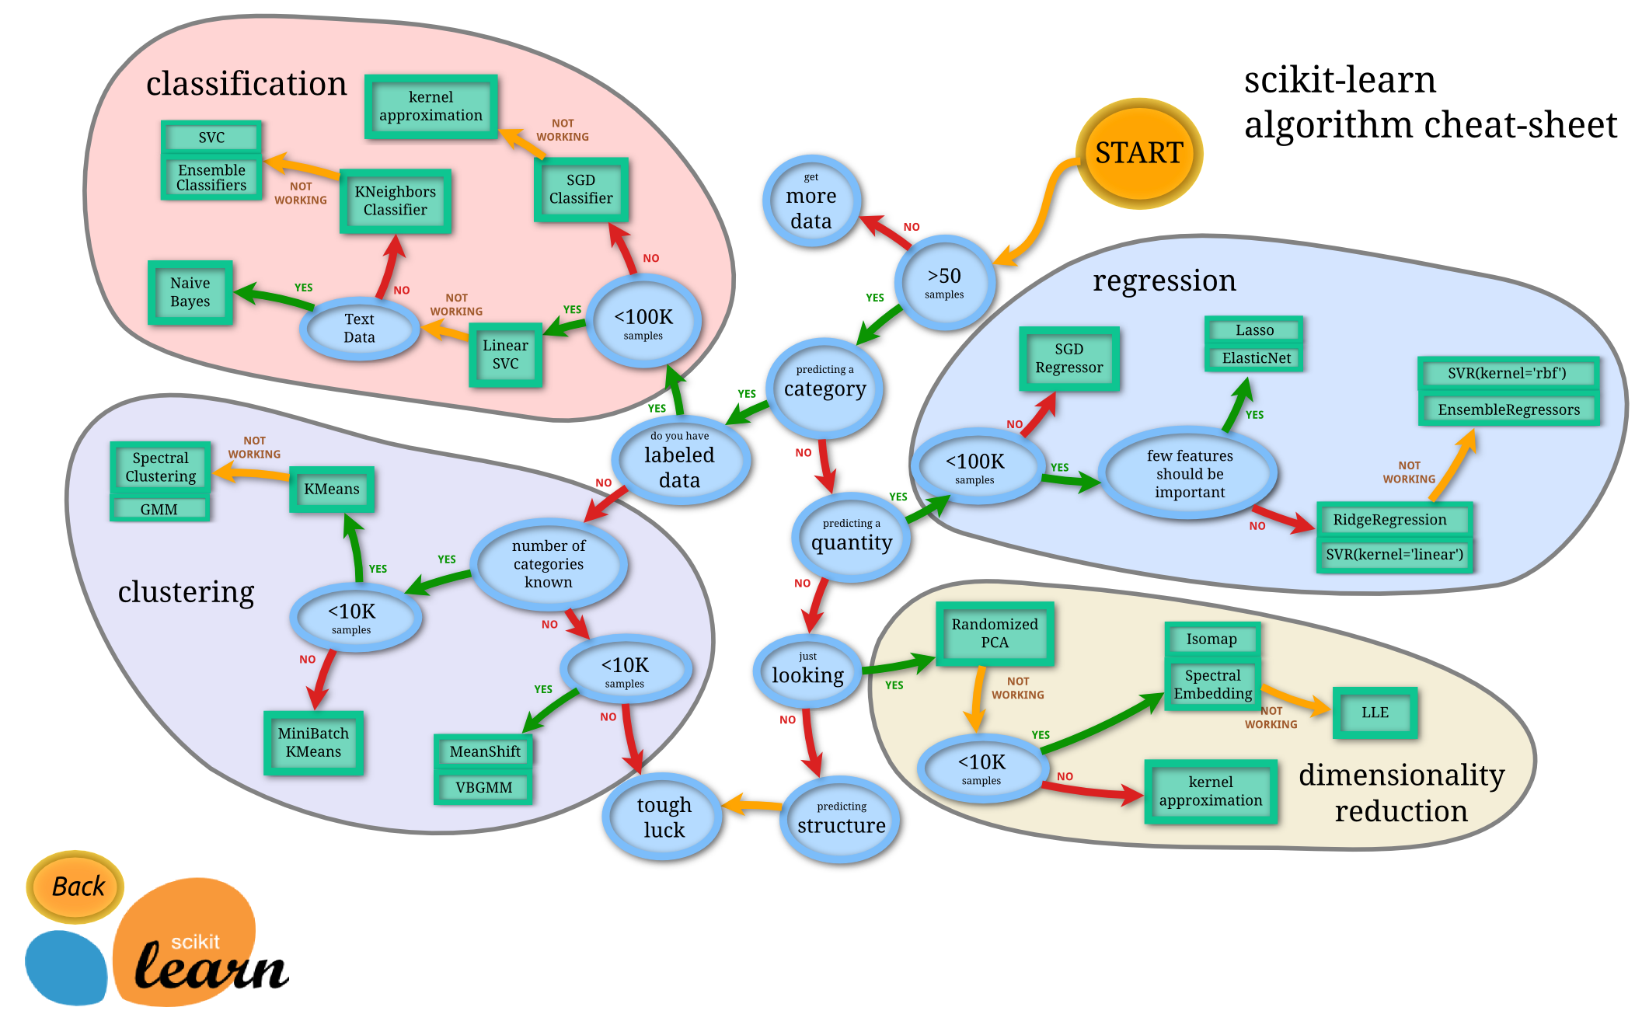

Slide 4
SUPERVISED LEARNING - REGRESSION & CLASSIFICATION
If the y variable is numeric then we have a regression problem - we are trying to predict a continuous number
If the y variable is a category (for example trying to predict a type of flower) the we have a classification problem - we are trying to classify what group that y belongs to.

Slide 5
WHAT IS LOGISTIC REGRESSION?
DATA SCIENCE PART TIME COURSE

Slide 6
LOGISTIC REGRESSION
We want to build a classifier that correctly identifies which class our target variable y belongs to given our input variable x.
Why not use the linear regression model?
y=Xβ+ϵ

Slide 7
LOGISTIC REGRESSION
If we only have a binary response variable (0 or 1) it might make sense… BUT we can have our estimated value of y > 1 or y < 0 … which doesn’t make sense.
What of the case where we have more than one class? Linear regression cannot easily handle these cases.
We want a classification method that can handle these cases and give us results we can easily interpret.

Slide 8
LOGISTIC REGRESSION
p(Y=1|X) = β₀ + β₁X.
This is a good starting point but we still have the problem of p(Y) being outside the 0,1 range.
We need to model p(Y=1|X) using a function that gives outputs between 0 and 1.
Basically we want something that looks like the following

Slide 9
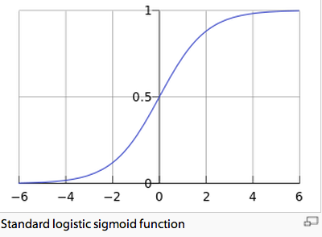
LOGISTIC REGRESSION

Slide 10
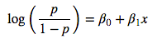
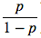
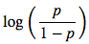
LOGISTIC REGRESSION
This is the logit function,
We can see that it this function is linear in X
is called the ‘odds’ and can be any value from 0 to ∞
is called the ‘log-odds’ or ‘logit’

Slide 11
LOGISTIC REGRESSION - WALKTHROUGH NOTEBOOK
We will step through a notebook together and cover these concepts in a more tangible way.

Slide 12

LAB
DATA SCIENCE PART TIME COURSE

Slide 13

SYNCHING A FORK
git remote -v
git remote add upstream https://github.com/ihansel/SYD_DAT_4.git
git remote -v
git fetch upstream
git checkout master
git merge upstream/master

Slide 14
DISCUSSION TIME
DATA SCIENCE - Week 3 Day 2
DISCUSSION TIME
Review of last week
Further Reading for Logistic Regression
Check in with homework/course project

Slide 15
WEEK 3

Slide 16
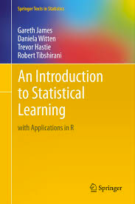
DISCUSSION TIME
An Introduction to Statistical Learning
Chapter 4 - Logistic Regression
Logistic Regression applied to loan applications
https://github.com/nborwankar/LearnDataScience
Odds Ratio in Logistic Regression
http://www.ats.ucla.edu/stat/mult_pkg/faq/general/odds_ratio.htm
DATA SCIENCE - Week 3 Day 2

Slide 17
DISCUSSION TIME
Homework/Course Project
How’s Homework 1 going ?
DATA SCIENCE - Week 3 Day 2

